Slide 1


Goodwin Living at a Glance
GoodwinLiving.org

Slide 2
Mission | Vision | Approach
Our Mission To support, honor and uplift the lives of older adults and the people who care for them
Our Vision Expand the places and ways we serve older adults
Our Approach We’re a not-for-profit, faith-based senior living and healthcare organization. We ensure that we can all thrive and live our lives with purpose at any age.

Slide 3

Our Range of Services

Slide 4
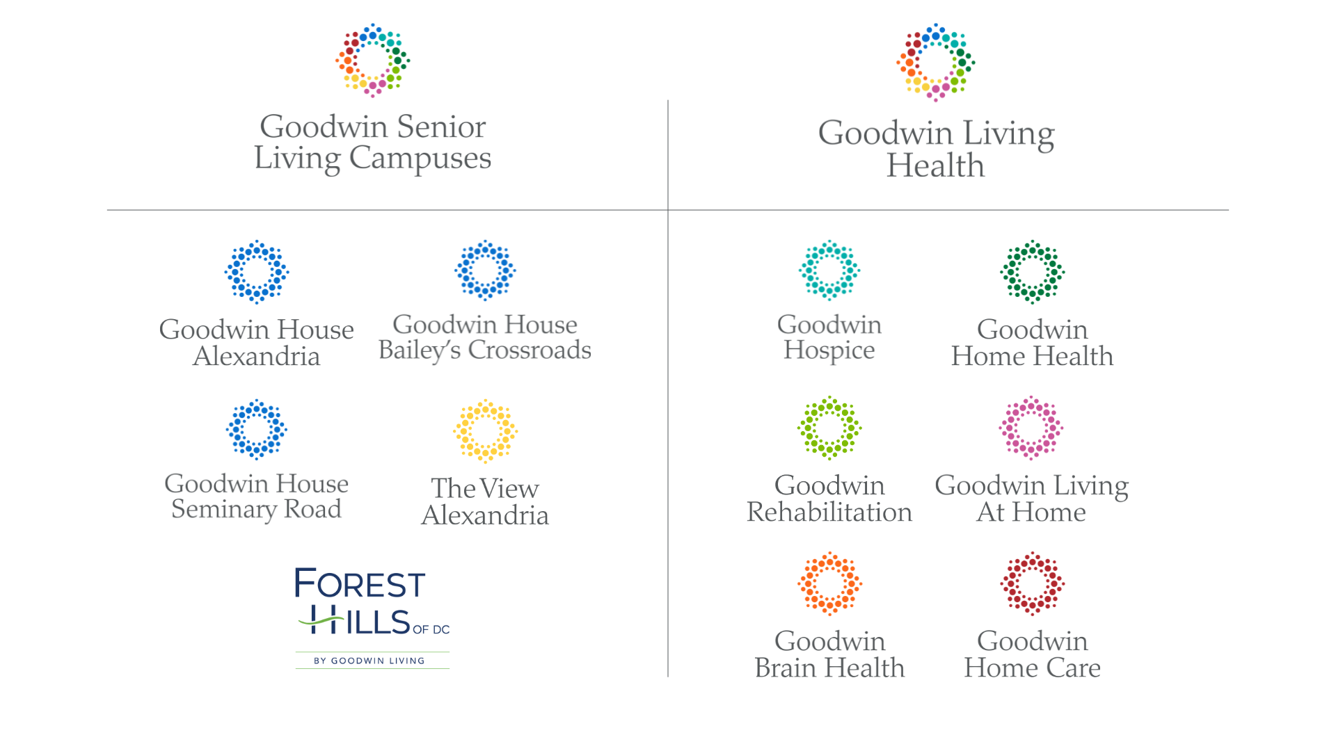

Slide 5


Other Innovative Offerings
A breakthrough brain health program that is designed for everyone. Easy to use and fun, StrongerMemory has been proven to be effective. It’s available at no cost to anyone who wishes to use it.
In 2018, we launched a U.S. citizenship program for our team members. With the U.S. facing a workforce crisis, we built a playbook designed to help other organizations start similar programs.

Slide 6
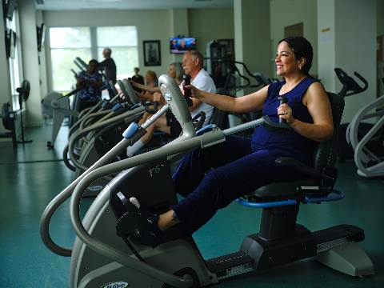
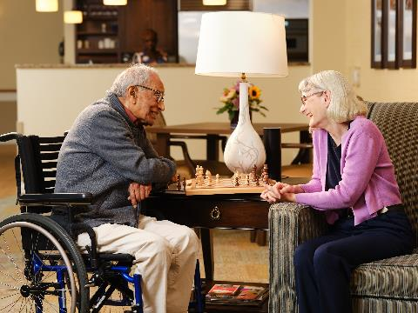
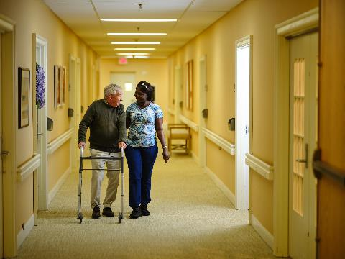
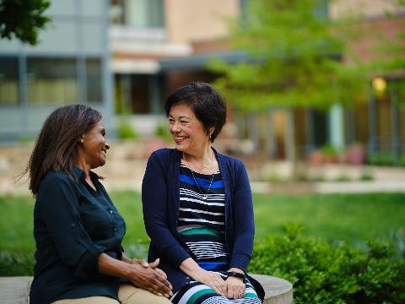




Campus Living & Lifestyle

Slide 7

Goodwin House Alexandria
Opened in 1967 | Our First Life Care Community

Slide 8
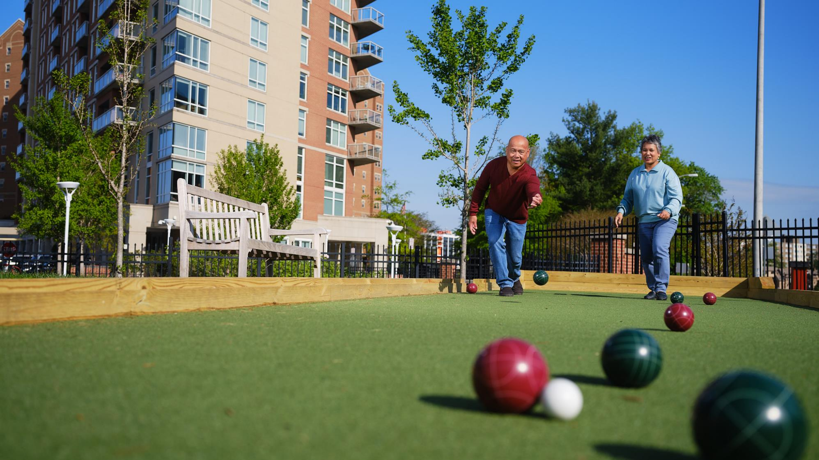
Goodwin House Bailey’s Crossroads
Opened in 1987 | Our Second Life Care Community

Slide 9
Campus Living & Lifestyle
Goodwin House Alexandria & Goodwin House Bailey’s Crossroads
* Life Care & Fee-for-Service Contract Options
* Entrance + Monthly Fees
* Independent Living, Assisted Living, Memory Support, Skilled & Long-Term Nursing Care – all on same campus
* Specialized services such as Home Care, Rehabilitation, Home Health & Hospice available right on campus from Goodwin Living Home & Community Based Services

Slide 10
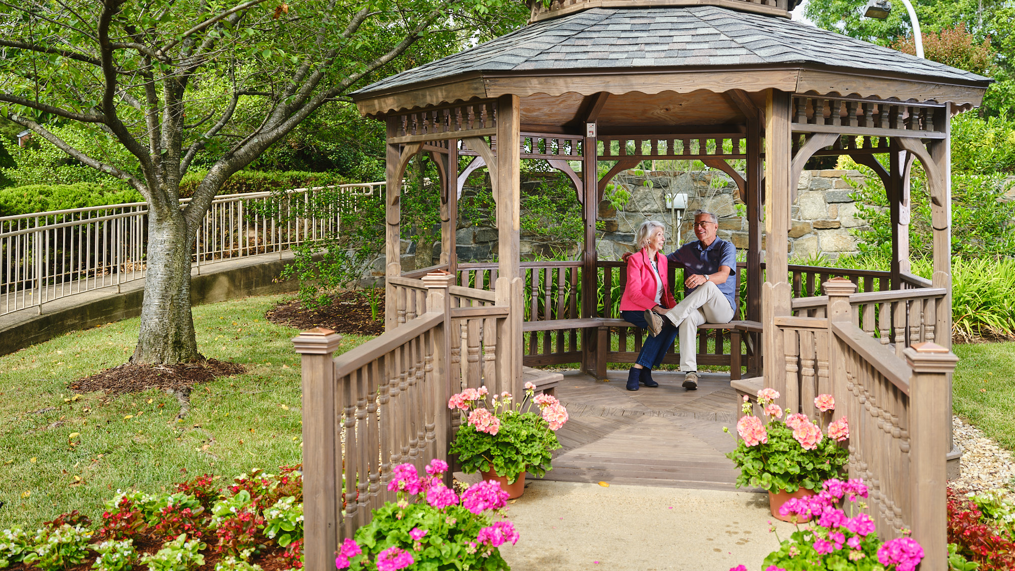
The View Alexandria by Goodwin Living
Acquired in 2022 | Our First Rental Community

Slide 11
Campus Living & Lifestyle
The View Alexandria by Goodwin Living (formerly Hermitage Northern Virginia)
* Fee-for-Service Contract
* Community + Month-to-Month Fees
* Independent Living, Assisted Living & Long-Term Nursing Care – all on the same campus
* Access to skilled nursing at other Goodwin Living campuses
* Specialized care services such as Home Care, Rehabilitation, Home Health & Hospice available right on campus from Goodwin Living Home & Community Based Services

Slide 12
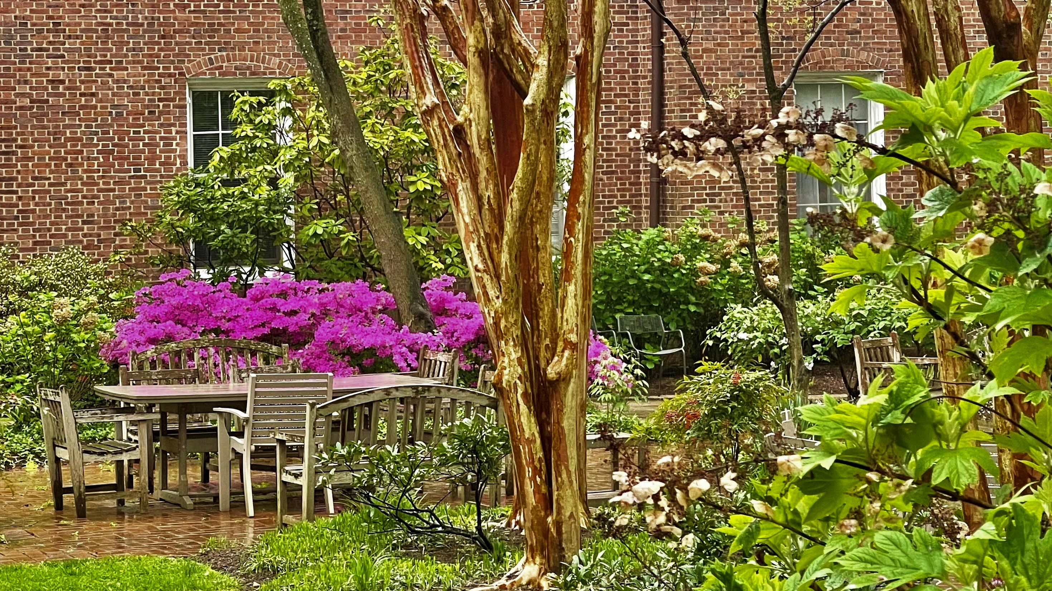
Forest Hills of DC by Goodwin Living
Affiliated in 2025 | Our First D.C.-Based Community

Slide 13
Campus Living & Lifestyle
Forest Hills of DC by Goodwin Living
* More than 130 years of service to older adults in D.C.
* Fee-for-Service Contract
* Community + Month-to-Month Fees
* Assisted Living, Memory Care, Short-Term Rehabilitation, Long-Term Nursing Care & Respite Care
* 5-star rating of 55-bed skilled nursing facility
* Walkable neighborhood steps away in NW D.C., featuring restaurants, shops, and Politics and Prose bookstore

Slide 14

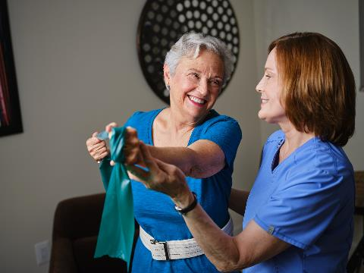
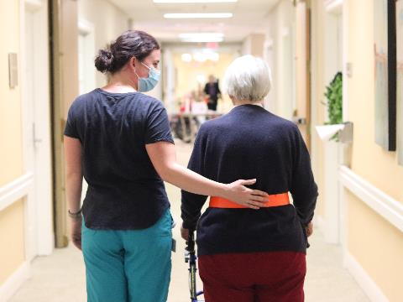
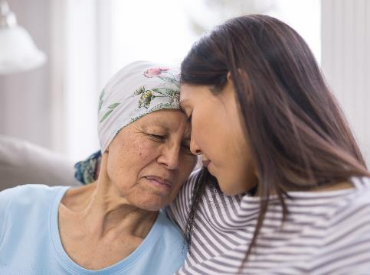





Options for Aging in Place

Slide 15
Options for Aging in Place
Goodwin Living At Home
* Active adults ages 55+ * Offers coverage for future care costs (in-home or in-facility) * Provides care coordination for members when needed * Other benefits: social events, annual check-ins, home safety assessments
Goodwin Rehabilitation
* Physical, Occupational, Cognitive & Speech Therapy services * Offered to those receiving rehabilitative services on our campuses * Limited out-patient services to Goodwin Living At Home Members

Slide 16
Options for Aging in Place
Goodwin Home Health
* Skilled nursing and therapy services delivered to you at home * Additional services from home health aide and social worker * Medicare-certified specialized healthcare service * Other forms of insurance also accepted
Goodwin Hospice
* Comfort care when you and your loved ones need it most * Comprehensive services coordinated with your own medical care team * Symptom control, personal care, social work and spiritual support * Provided to individuals 18 and older with terminal illness

Slide 17
Options for Aging in Place
Goodwin Home Care
* Personal Care, homemaking services, companionship, medical and social appointment escort services
* Caregivers are trained in StrongerMemory, a brain health program designed to help those facing mild cognitive challenges or an early diagnosis of dementia
* Home Exercise Program (HEP) * Licensed Certified Nursing Assistants (CNA) and Personal Care Aides (PCA) who provide your personal care services
* 24-hour on call support

Slide 18

Other Innovative Offerings
30 Minutes A Day 3 Simple Exercises

Slide 19
Other Innovative Offerings
Proven Effective Research in Partnership with George Mason University
Easy to Use 30 minutes a day spent doing simple math, reading out loud writing by hand
Available at No Cost
download the workbook and follow us on Facebook to stay in touch and find groups

Slide 20
Other Innovative Offerings
Inspired by a resident who helped our Foundation to launch the program in 2018
Available to team members and their family members
Offers grant funds to pay for application fees
Connects team members with resident tutors who help them prepare for the exam
More than 150 grant recipients!

Slide 21
Your Partner in Aging
Whether you prefer to age in your own home or move to a campus to enjoy community lifestyle, Goodwin Living is here to help you realize your dreams and age in the places and ways you wish.
We also welcome anyone seeking to pursue a career that offers opportunities to grown and work with purpose.

Slide 22

Live Your Life With Purpose
Learn more at GoodwinLiving.org

