Slide 1


Goodwin Living
at a Glance
GoodwinLiving.org

Slide 3

Goodwin House Alexandria
Opened in 1967 | Our First Life Plan Community

Slide 4

Goodwin House Bailey’s Crossroads
Opened in 1987 | Our Second Life Plan Community

Slide 5

Our Range of Services Today

Slide 6
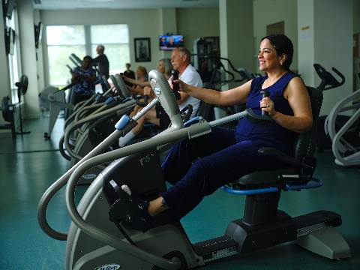
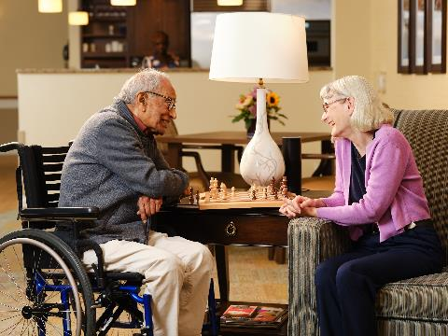
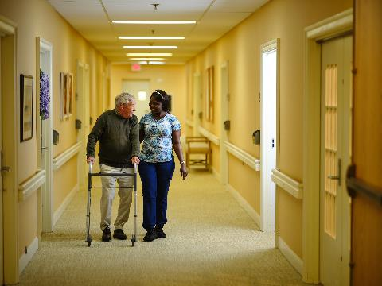
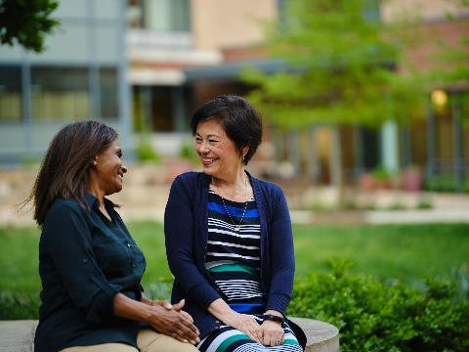



Campus Living & Lifestyle

Slide 7
Campus Living & Lifestyle
Goodwin House Alexandria & Goodwin House Bailey’s Crossroads
* Lifecare & Fee-for-Service Contract Options / Entrance + Monthly Fees
* Independent Living, Assisted Living, Memory Support,
Skilled Rehab & Long-Term Nursing Care
* Specialized care services such as Home Care, Rehabilitation,
Home Health & Hospice
The View Alexandria by Goodwin Living (formerly Hermitage Northern Virginia)
* Fee-for-Service Agreement / Community + Month-to-Month Fees
* Independent Living, Assisted Living & Long-Term Nursing Care
* Specialized care services such as Home Care, Rehabilitation,
Home Health & Hospice

Slide 8

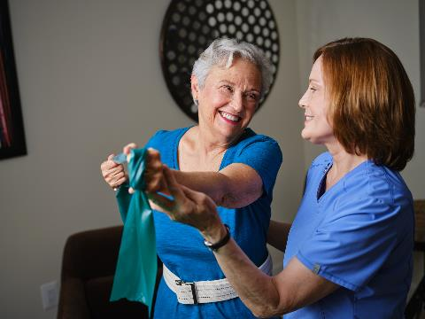
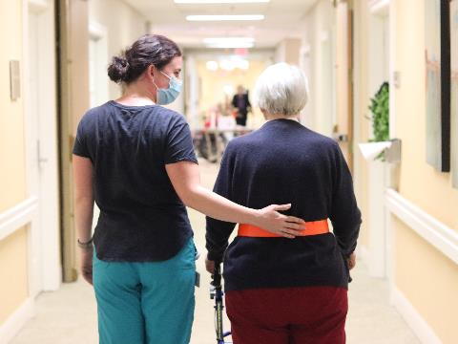





Options for Aging in Place

Slide 9
Options for Aging in Place
Goodwin Living At Home
* Active adults ages 55+
* Offers coverage for future care costs (in-home or in-facility)
* Provides care coordination for members when needed
* Other benefits: social events, annual check-ins, home safety assessments
Goodwin Rehabilitation
* Physical, Occupational, Cognitive & Speech Therapy services
* Offered to those receiving rehabilitative services on our campuses
* Limited out-patient services to Goodwin Living At Home Members

Slide 10
Options for Aging in Place
Goodwin Home Health
* Skilled nursing and therapy services delivered to you at home
* Additional services from home health aide and social worker
* Medicare-certified specialized healthcare service
* Other forms of insurance also accepted
Goodwin Hospice
* Comfort care when you and your loved ones need it most
* Comprehensive services coordinated with your own medical care team
* Symptom control, personal care, social work and spiritual support
* Provided to individuals 18 and older with terminal illness

Slide 11

Your Partner in Aging
Whether you prefer to age in your own home or move to a campus to enjoy community lifestyle, Goodwin Living is here to help you realize your dreams and age in the places and ways you wish.

Slide 12

Live Your Life With Purpose
Learn more at GoodwinLiving.org

